Slide 1

BODY LANGUAGE DETECTION USING MACHINE LEARNING
DEPARTMENT OF ARTIFICIAL INTELLIGENCE AND DATA SCIENCE
Guide Name: Prof. Varsha P. Chavan

Slide 2
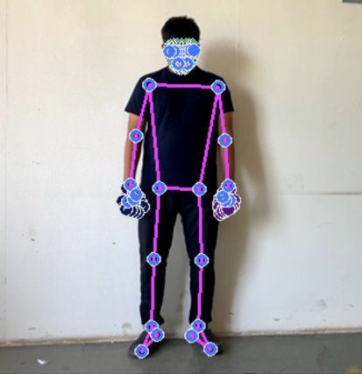
Body Language Detection Using Machine Learning
Guide Name : Prof Varsha Chavan
Group Members:
1) Mahesh Bhosle
2) Prathamesh Chaudhari
3) Rahul Jagtap
4) Yash Shevkar

Slide 3
Problem Statement
To Detect the Emotion and Intention of an Individual by Analyzing their Body Language without any Verbal Conversation.

Slide 4
Introduction
Literature Survey
Objectives
Training Architecture
Methodology
System Requirements
System Architecture
Code Snippets
Results
Reference
Achievements

Slide 5
Introduction
Body language is a fundamental form of non-verbal communication, plays a significant role in human interaction.
It encompasses gestures, postures, facial expressions, and various subtle movements that convey emotions, attitudes, and intentions.
Understanding and interpreting body language can be crucial in discerning unspoken cues during communication.
The Main objectives are body detection, a skeletal representation, body language features extraction, and finally, emotion detection based on these features.

Slide 6
Literature Survey
1. Ahmed, Mahbub; Islam, Md Rafiqul (2023).
This paper presents and helps us to understand "A novel approach to human body motion analysis using deep learning."
2. Singh, Harpreet; Kumar, Dinesh (2023).
This paper presents and helps us to understand "Machine learning-based body language analysis for non-verbal communication."

Slide 7
Literature Survey
3. Khan, Muhammad Salman; Ullah, Sarfaraz (2024).
This paper presents and helps us to understand "Human pose estimation using advanced deep learning techniques."
4. Zhou, Wei; Zhang, Jian-Min (2024).
This paper presents and helps us to understand "Integrated body gesture recognition framework for interactive applications."

Slide 8
Objectives
Behavioral Analysis: Read body language to identify patterns in behavior that can be applied to customer service, security, and workplace safety.
Healthcare and Rehabilitation: Create a system to track patient progress or identify odd movement patterns while keeping an eye on body movements for physical therapy or rehabilitation and sports.
Emotional Recognition: Develop a model that uses gestures, body position, and facial expressions to identify and categorize emotional states such as happiness, rage, sadness or confidence .

Slide 9
Training Architecture
Camera
Data Collection
Preprocessing
Model Evaluation
Model Training
Model Selection
Real-Time Processing
Results Display

Slide 10
Methodology
Our Project Include following Phases:
1. Setting up Dependencies
2. Capturing Landmarks
3. a)Model Selection
b)Model Training
c)Model Evaluation
Making Detection

Slide 11
Algorithms
MediaPipe
It is a open-source framework for building pipelines to perform computer vision inference over arbitrary sensory data such as video or audio. This framework is mainly used for rapid prototyping of perception pipelines with AI models for inferencing. It also facilitates the deployment of computer vision applications into demos and applications on different hardware platforms.
Classification Algorithms
MLP Classifier – It implements a multi-layer perceptron (MLP) algorithm that trains using Backpropagation.
Decision Tree Classifier – It is a class capable of performing multi-class classification on a dataset.
Gradient Boosting Classifier - This model repeatedly selects a function that leads in the direction of a weak hypothesis or negative gradient so that it can minimize a loss function.

Slide 12
Libraries:-
Methodology
1.OpenCV
2.Scikit-Learn
3.Numpy
4.Pandas
5.Mediapipe
6.Flask

Slide 13
.
System Requirements
Software Requirements
Programming Language: Python 3.11.7
2. Hardware Requirements
Processor: Intel i5 and above.
Operating System: Windows / Linux.
Ram: 4GB or Higher.
Disk Space: Varies according to datasets and samples.
Camera: Sensor Resolution 1080P 2 Megapixel.

Slide 14
System Architecture
Stress
Offended
Body Language Classification
Start
Access Camera Module
Lying
Interested
Victory

Slide 15
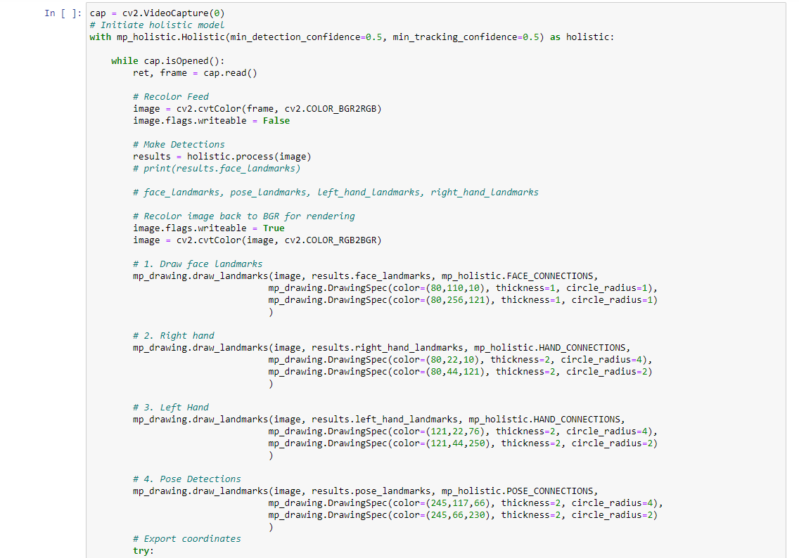
Code Snippets - Capture Landmarks & Export to CSV

Slide 16
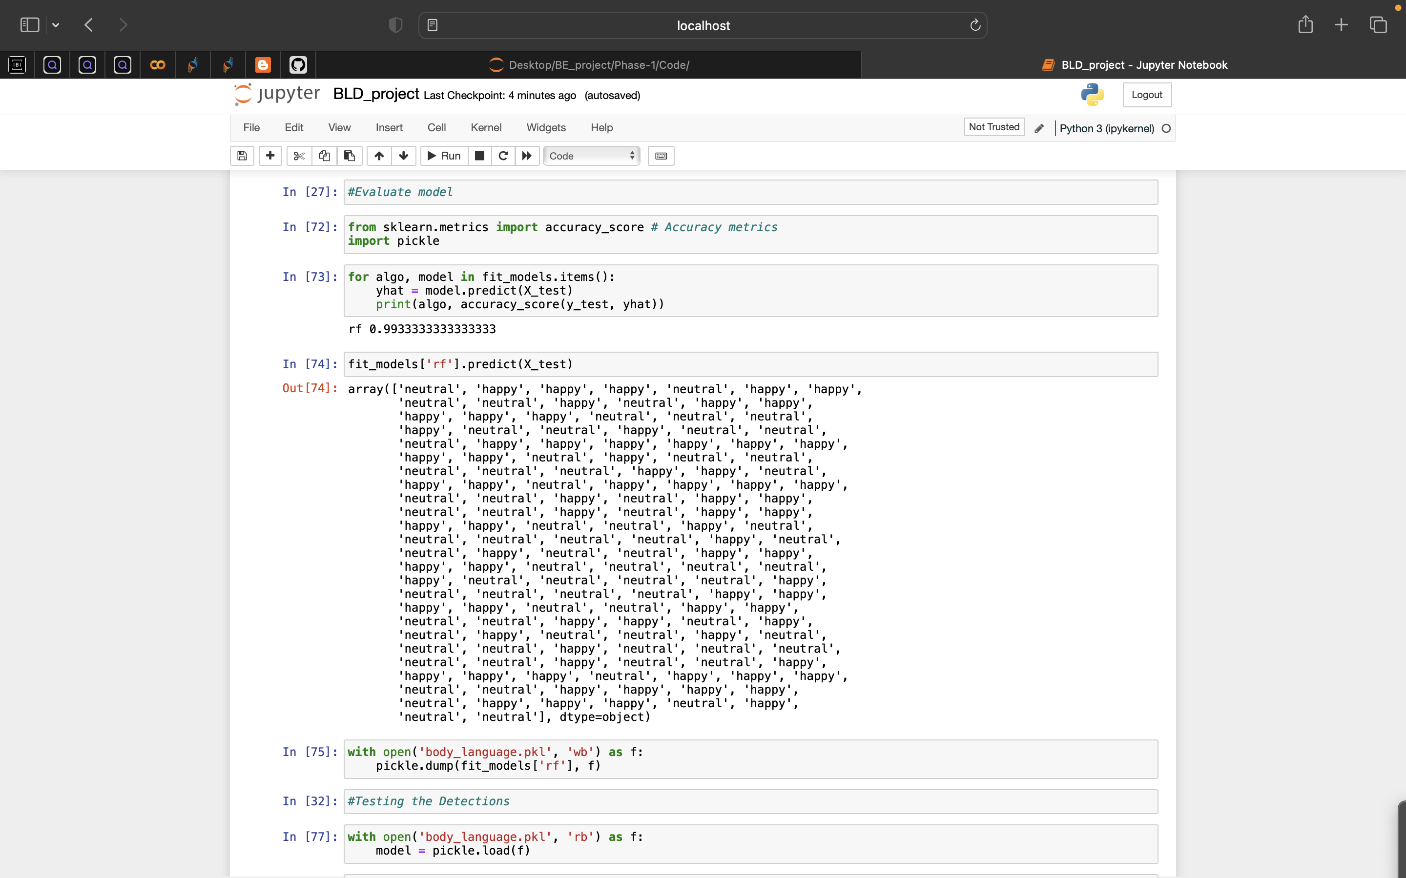
Code Snippets – Data Training

Slide 17
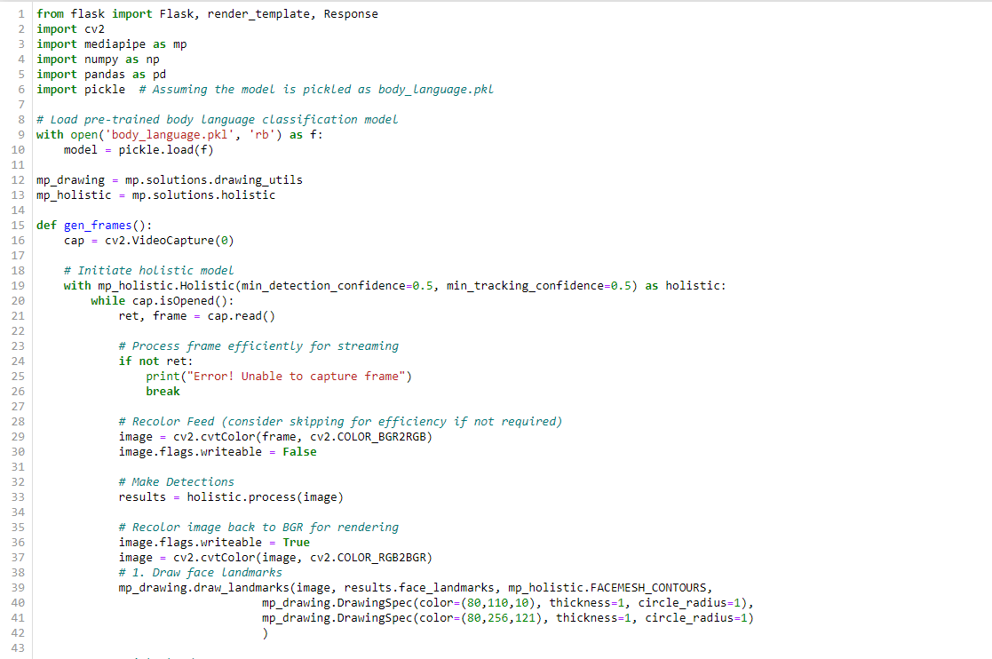
Code Snippets – Flask Framework and detection

Slide 18
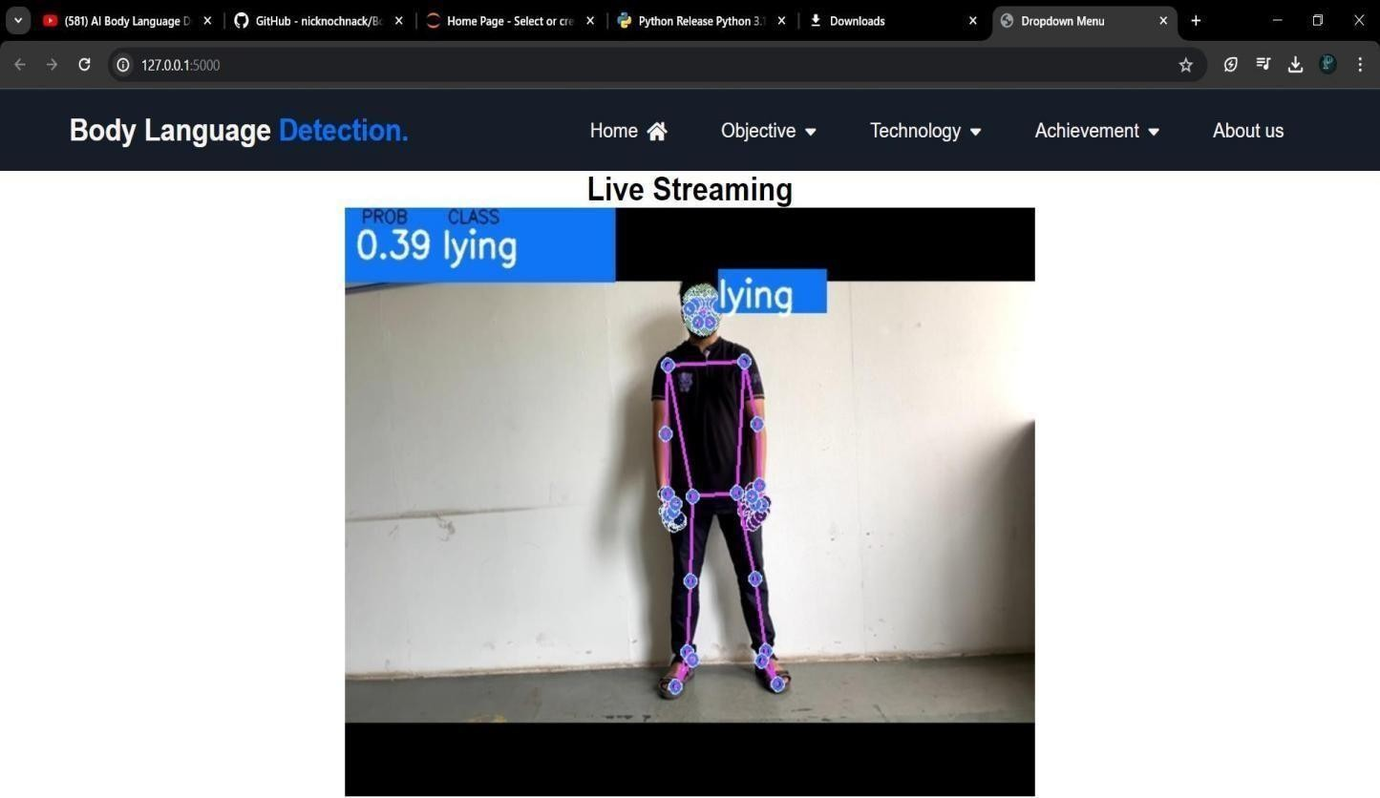
Results
.

Slide 19
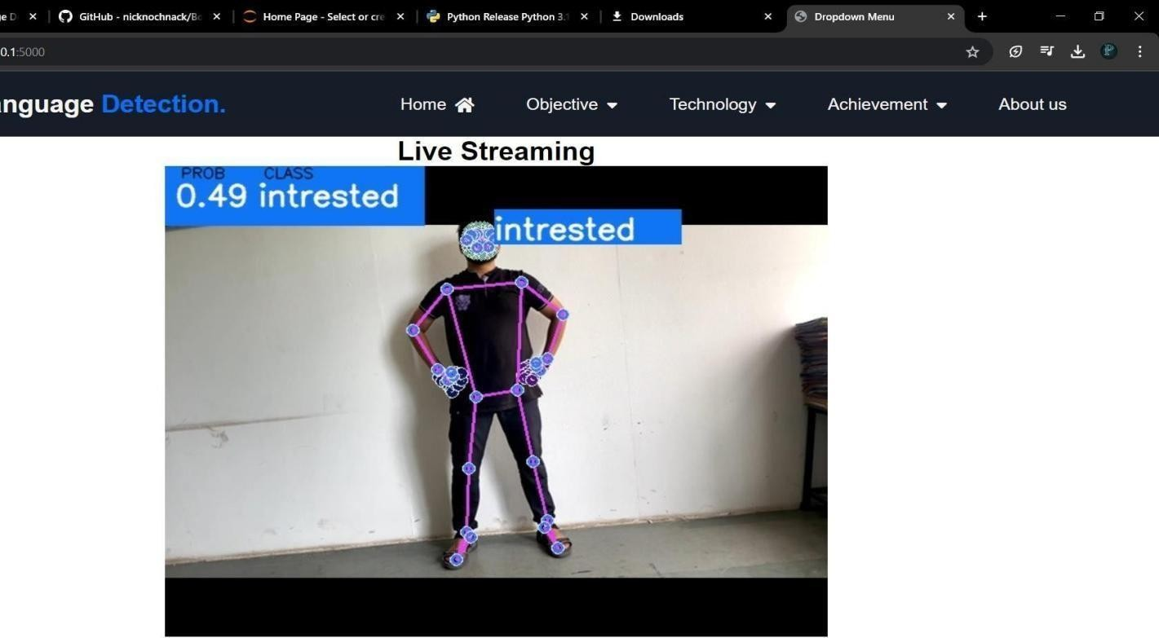
Results
.

Slide 20
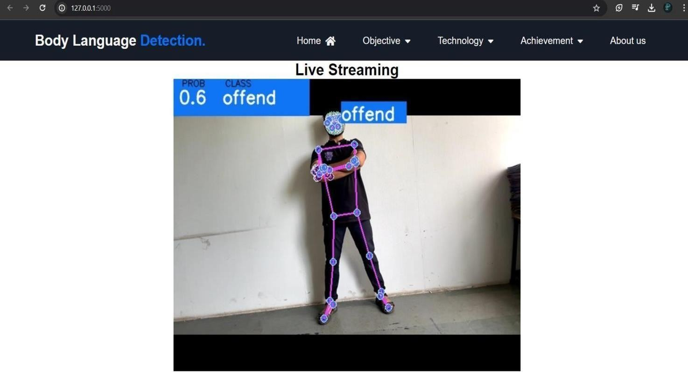
Results
.

Slide 21
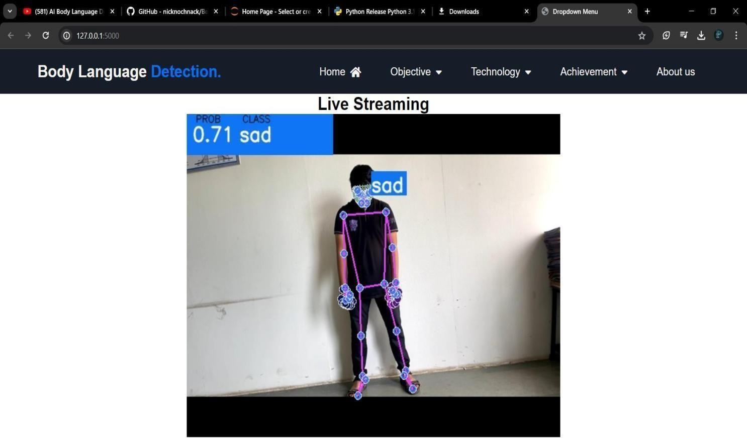
Results
.

Slide 22
Reference
Ahmed, Mahbub; Islam, Md Rafiqul (2023).
Singh, Harpreet; Kumar, Dinesh (2023).
Khan, Muhammad Salman; Ullah, Sarfaraz (2024)
.
Zhou, Wei; Zhang, Jian-Min (2024).

Slide 23
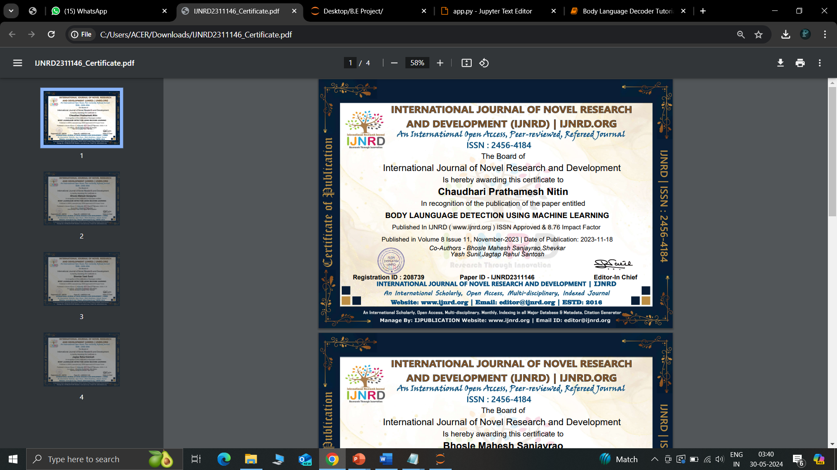
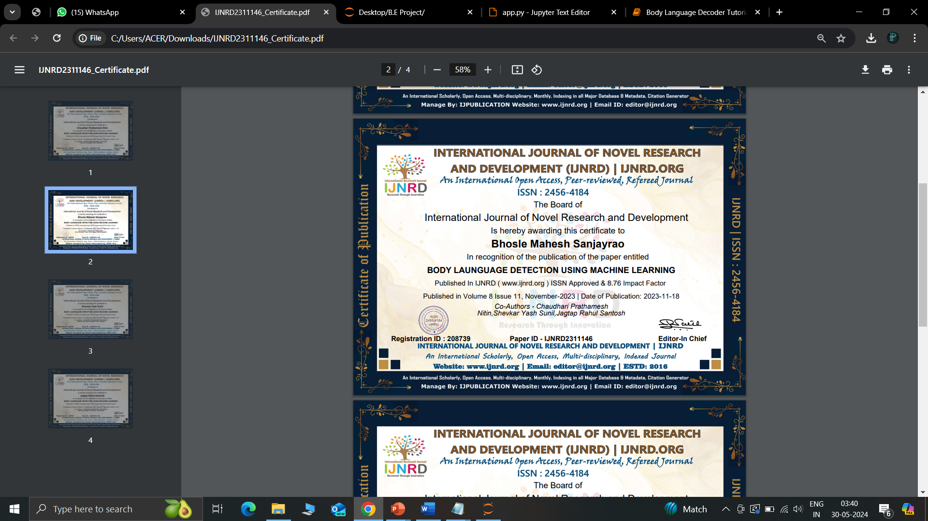
International Journal of Novel Research and Development Certificate of Publication

Slide 24
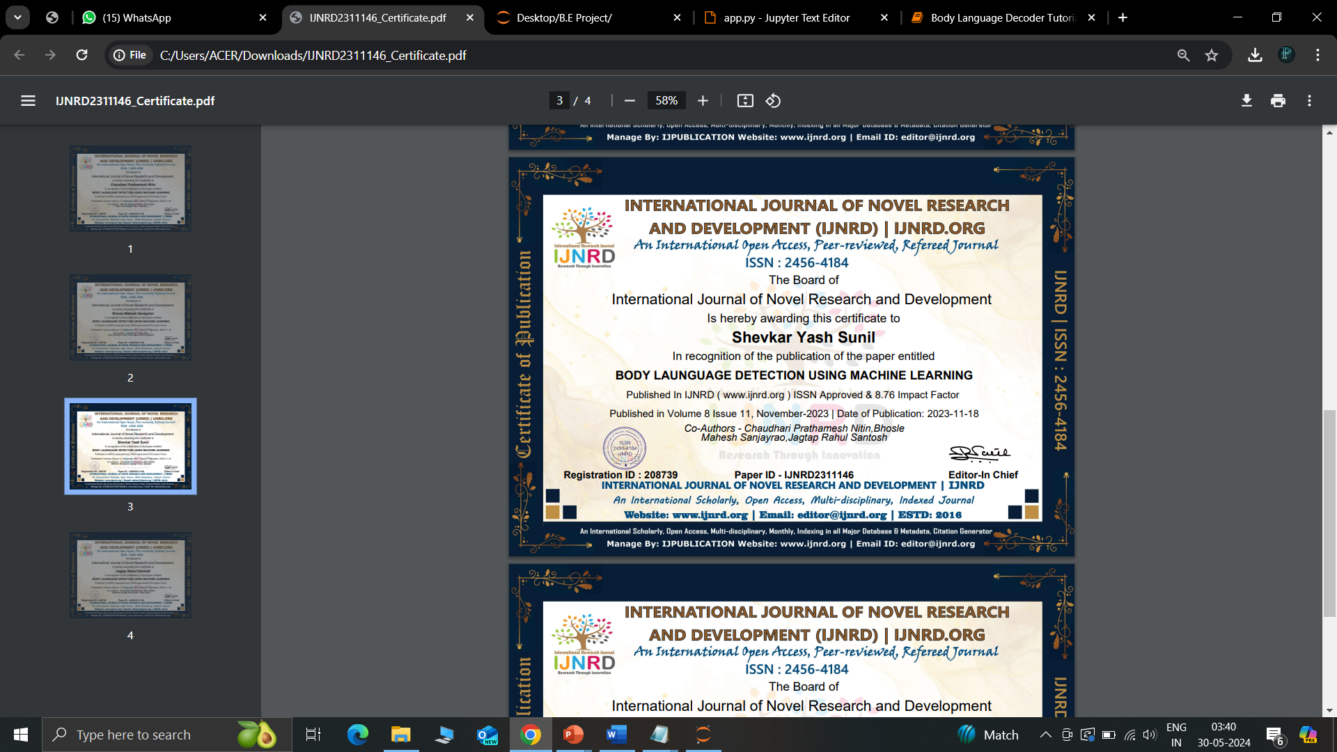
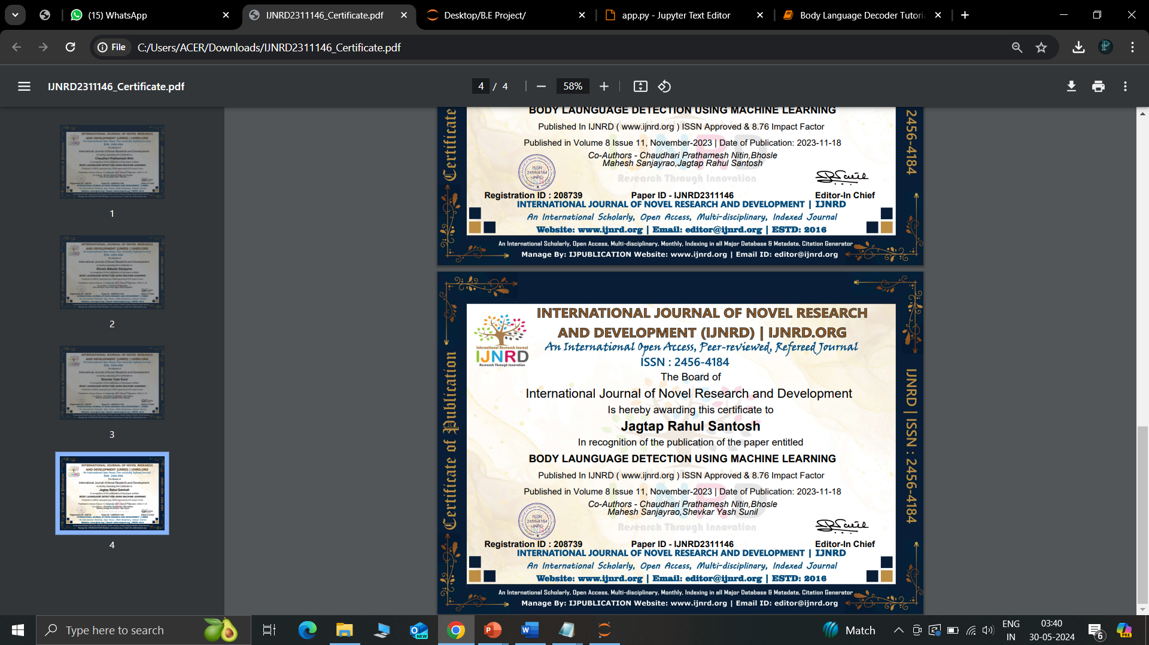
International Journal of Novel Research and Development Certificate of Publication

Slide 25
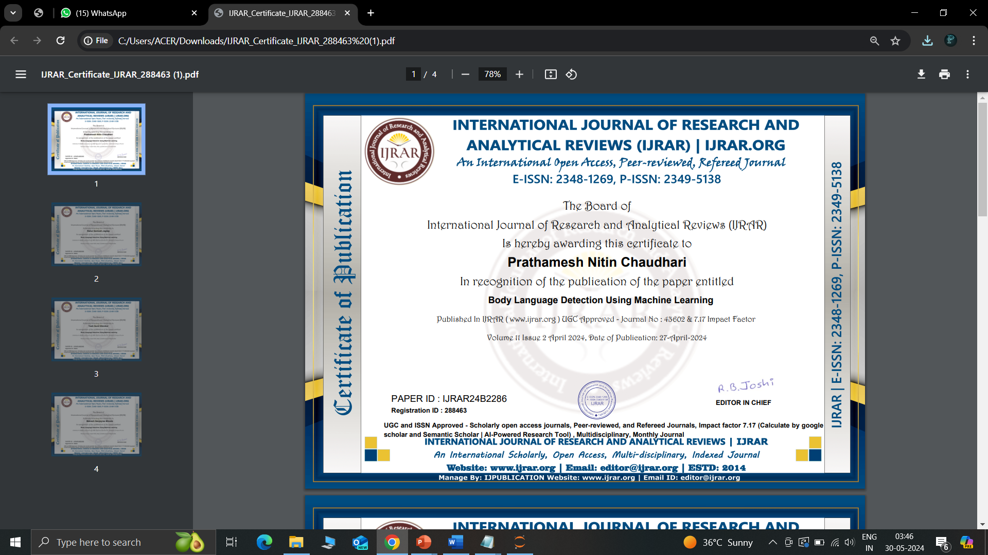
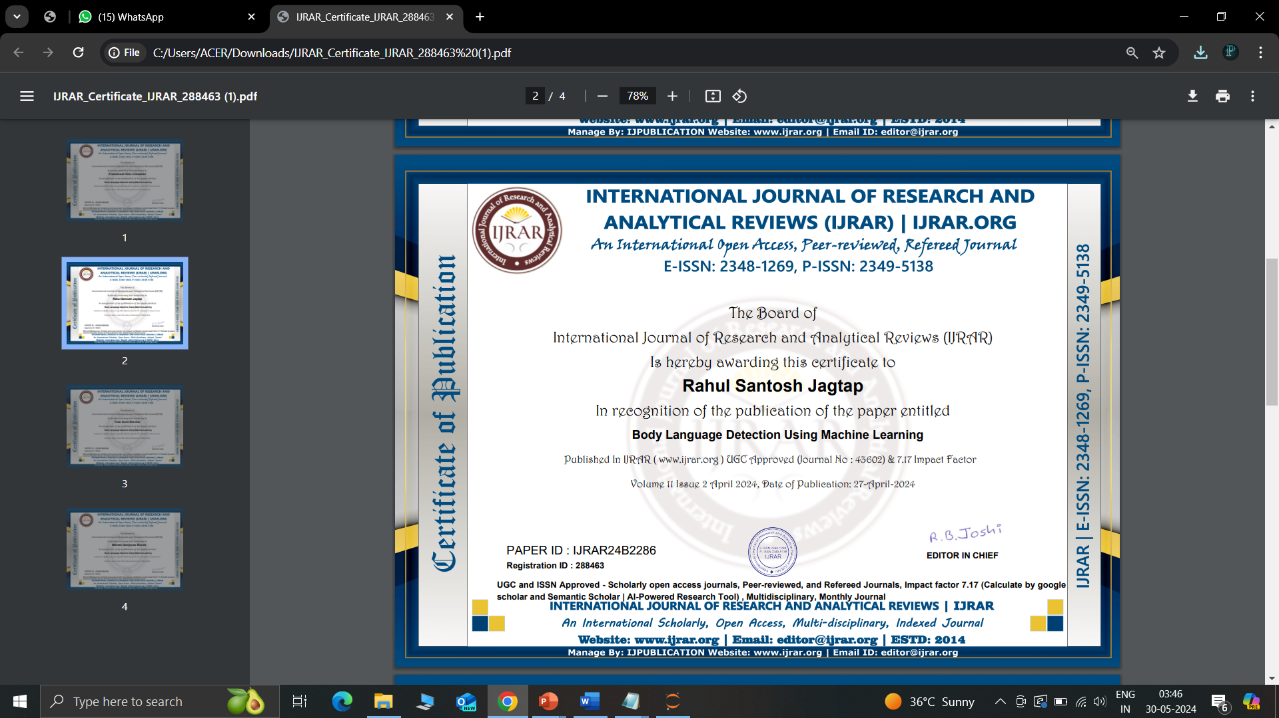
International Journal of Research and Analytical Reviews Certificate of Publication

Slide 26
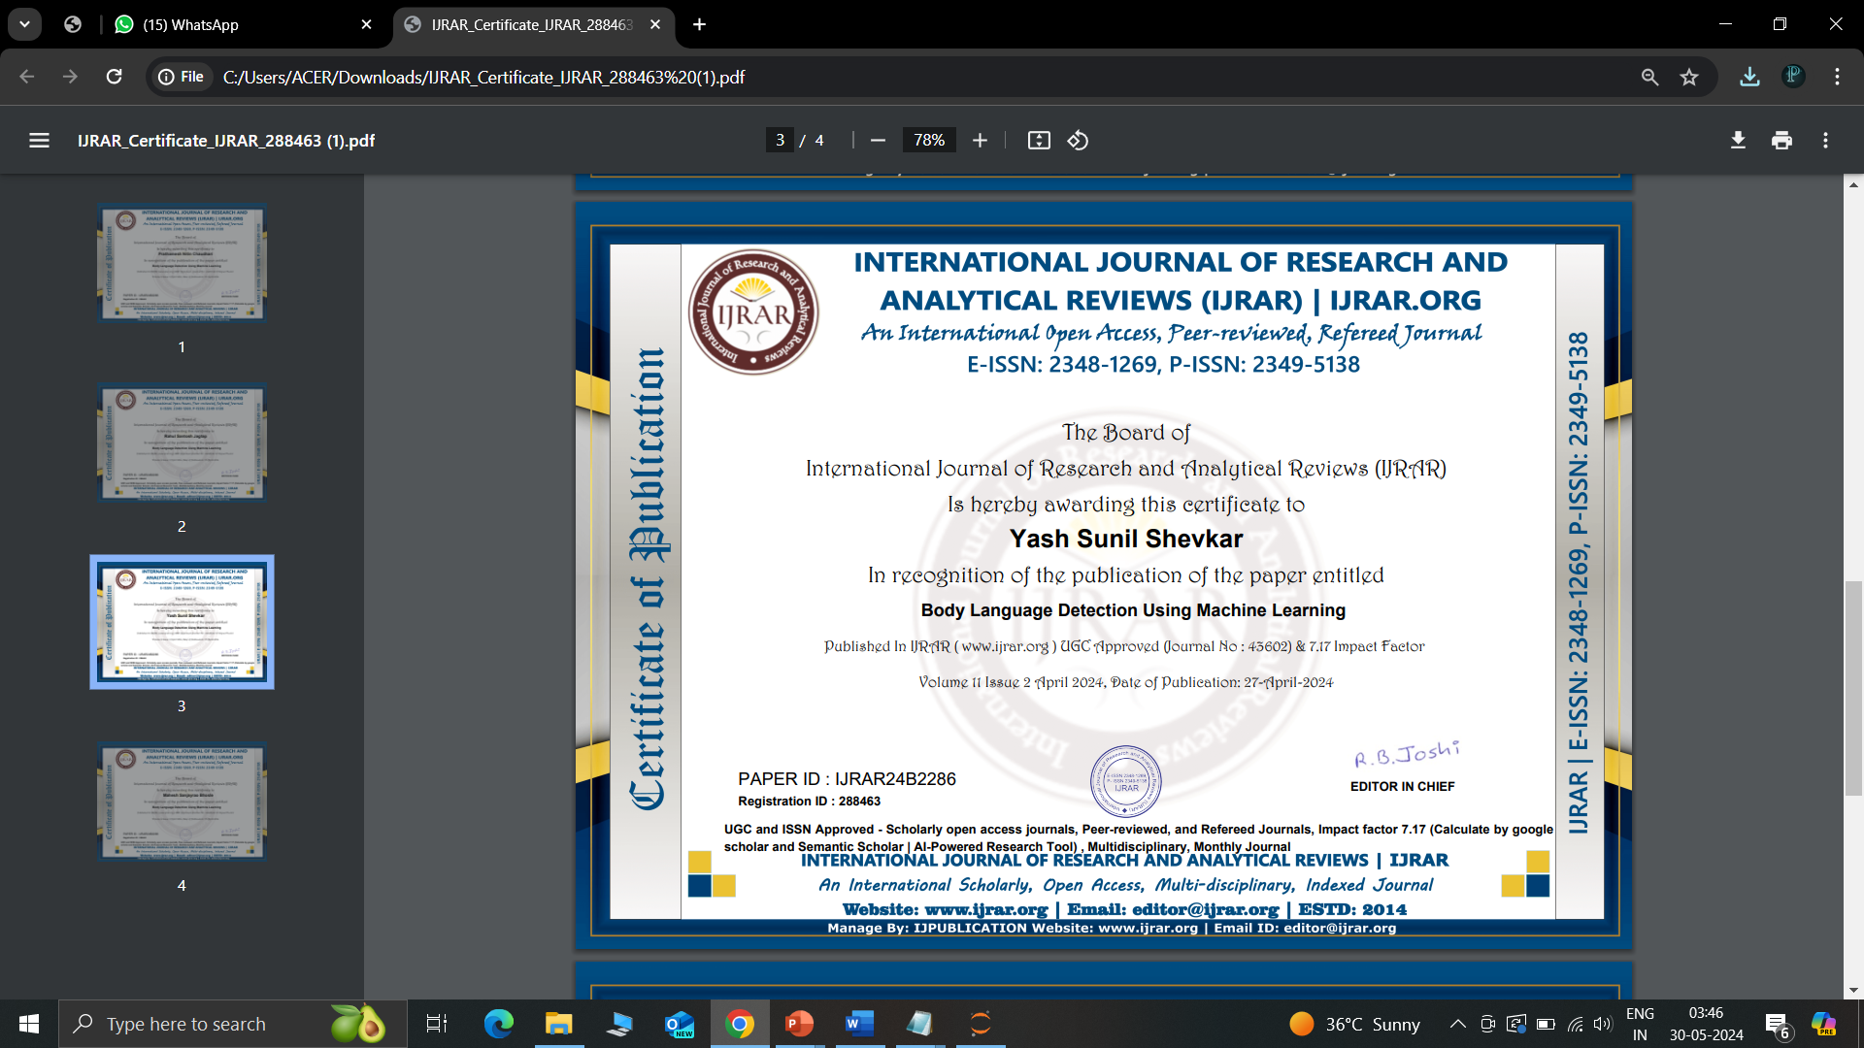
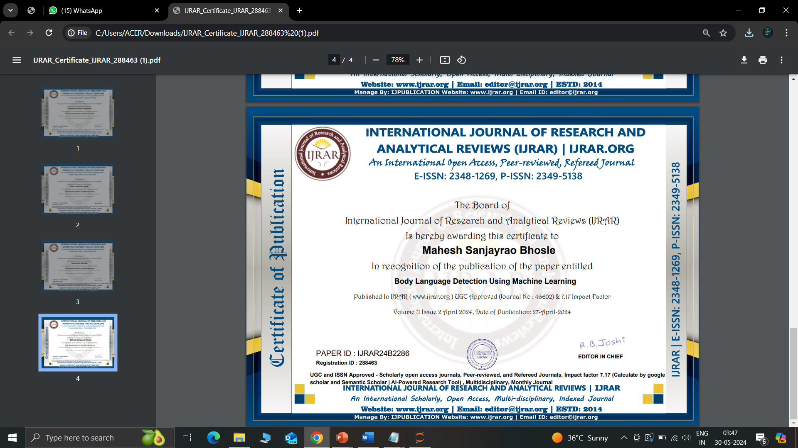
International Journal of Research and Analytical Reviews Certificate of Publication

Slide 27
Thank You!

